Slide 1
Hot Dog Detector
Alwyn Lopez

Slide 2
Specifications of The Model and Training Process
Convolutional Neural Network Architecture: mobilenet_v2_035_128
Fully Connected Neural Network Architecture:
ReLU Layer with 70 nodes.
Output Layer with 2 nodes. (To give out the logits for the model then afterwards compute the softmax cross entropy).
Adam Gradient Descent
Learning rate = 0.01
Number of Epochs = 100
Batch Size = 100

Slide 3
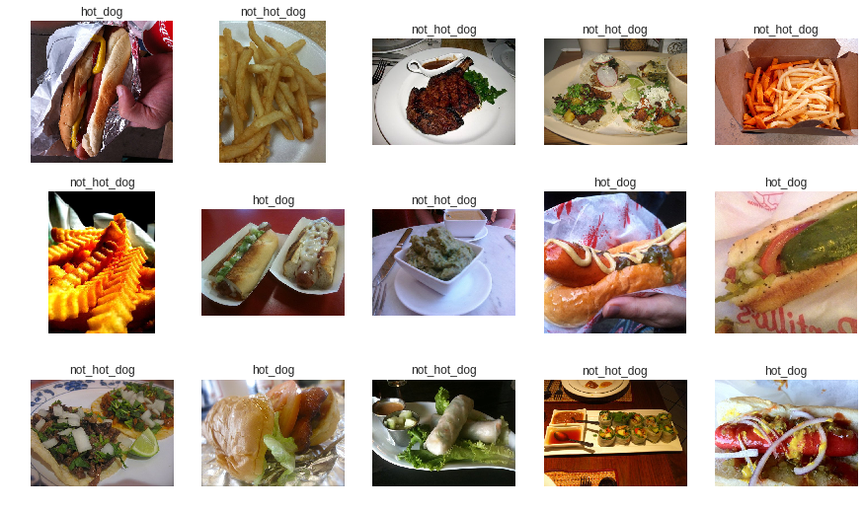
Example Pictures

Slide 4
Training Process of the Model
Split the Data into two sets: Train Set (80%) and Test Set (20%)
Train on the Train Set, and for every 10 epochs check the accuracy on the Test Set.
Test accuracy at step 0: 50.00%
Test accuracy at step 10: 50.00%
Test accuracy at step 20: 50.00%
Test accuracy at step 30: 50.00%
Test accuracy at step 40: 50.00%
Test accuracy at step 50: 82.50%
Test accuracy at step 60: 85.00%
Test accuracy at step 70: 85.50%
Test accuracy at step 80: 86.50%
Test accuracy at step 90: 86.00%
Test accuracy at step 99: 86.50%

Slide 5
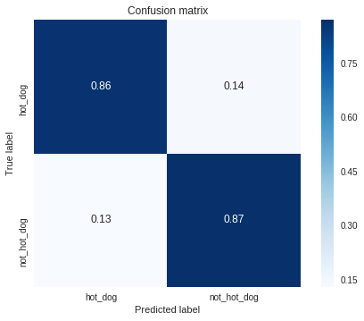

Slide 6
